Slide 1
Real-Time Restaurant Management & POS System
Guide :
Ms. Sherna Mohan
Aaliya Khalid (01) MCA 3A
Ambadi K J (09) MCA 3A

Slide 2
Project Details & Technology Stack
Frontend
Backend
Database
Dev-tools
React.js
TypeScript
Tailwind CSS
Vite
  Node.js
  Express.js
  PostgreSQL
  Prisma ORM
  Visual Studio Code
  Git & GitHub
  pgAdmin 4

Slide 3
Introduction
The real-time restaurant management & POS system is a web-based application developed to automate restaurant operations. It provides qr-code based ordering, real-time kitchen updates, secure billing, inventory management, and role-based access for different users.

Slide 4
Existing System
High risk of billing and order errors
Lagging inventory updates
Slow peak-hour billing
Manual waiter-to-kitchen communication
Paper-based ordering process

Slide 5
Proposed System
QR Code based ordering
Real-time Kitchen Display System (KDS)
Live inventory updates
Secure session-based billing
Faster order processing using WebSockets
Role-based access control

Slide 6
Modules
User Registration & Login
Provides secure, role-based access for Admins, Cashiers, and Kitchen Staff, redirecting them to specific dashboards.
Allows Admins to manage the live catalog, set daily stock limits, and instantly update the Customer QR menu.
Menu & Inventory Control
Manages QR-activated customer sessions, tracking live table availability and preventing cross-table billing errors.
Table & Session Operations
Synchronizes continuous customer orders directly to the Kitchen Display System while validating real-time inventory.
Order Processing
Payment Processing
Aggregates all session orders, processes payments via Cash or UPI, and generates a final digital invoice.

Slide 7
Architecture Diagrams

Slide 8
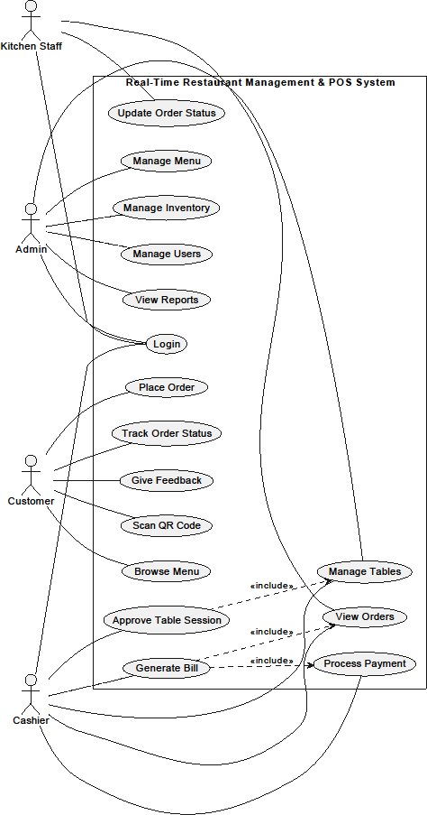
    Use Case diagram
Primary Actors: Admin, Cashier, Kitchen Staff, Customer.
Customer Scope: Scan QR, browse menu, place orders, track status, give feedback.
Cashier Scope: Approve table sessions, manage tables, view orders, generate bills, process payments.
Kitchen Scope: View incoming orders and update order statuses.
Admin Scope: Manage menu, inventory, system users, and view analytics.

Slide 9
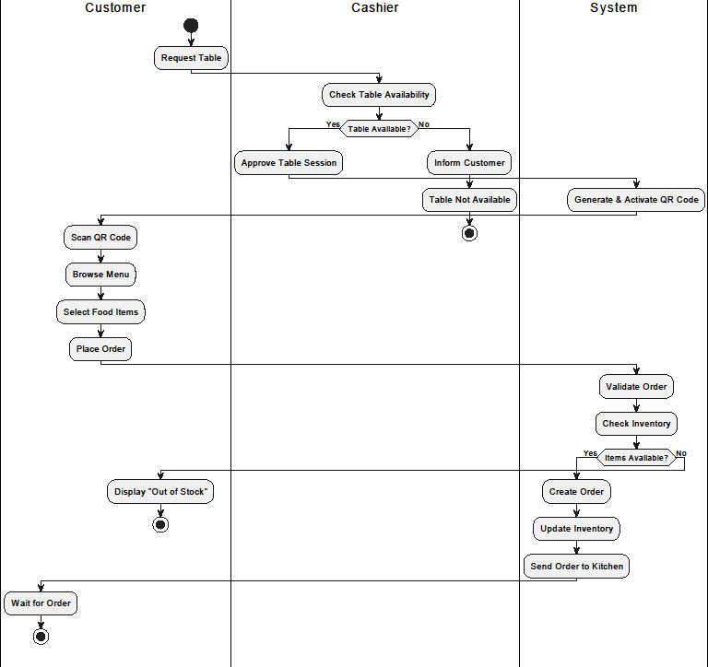
    Activity diagram
Customer table booking and food ordering
Session Setup: Cashier checks table availability and activates QR code upon approval.
Order Placement: Customer scans QR, browses menu, selects items, and places order.
System Validation: System checks stock; alerts "Out of Stock" if unavailable.
Fulfillment: Creates order, updates inventory, and sends KOT to kitchen.

Slide 10
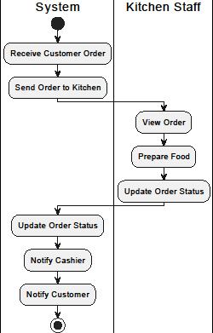
    Activity diagram
      Kitchen order processing
Order Transmission: System receives customer order and instantly routes KOT to kitchen.
Preparation & Status Update: Kitchen staff view order, prepare food, and update status on KDS.
System Broadcast: System logs status change and sends real-time notifications to Cashier and Customer.

Slide 11
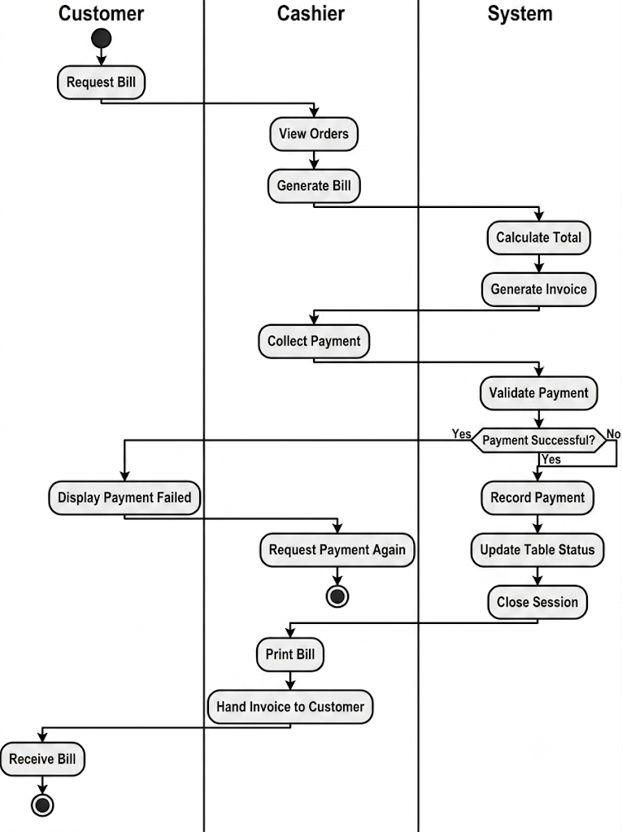
    Activity diagram
      Billing and payment management
Bill Generation: Customer requests bill; Cashier views orders and triggers invoice calculation.
Payment Validation: System calculates total and validates collected payment.
Failure Handling: If payment fails, system alerts Customer and Cashier requests retry.
Session Closure: On success, system records payment, frees table status, closes session, and Cashier prints invoice.

Slide 12
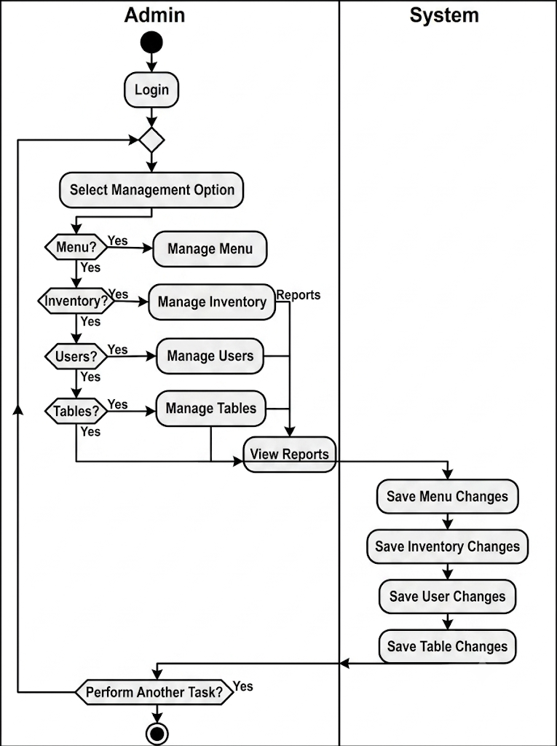
    Activity diagram
      Admin management
Authentication: Admin logs in to access management dashboard.
Task Selection: Choose module to manage: Menu, Inventory, Users, Tables, or Reports.
System Execution: System updates and saves changes to database automatically.
Session Loop: Admin can perform additional tasks or terminate session.

Slide 13
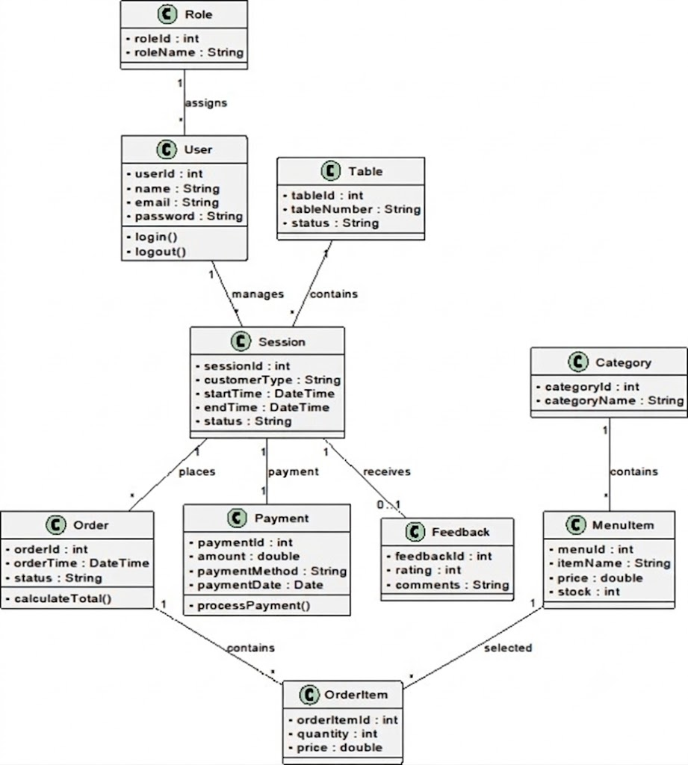
    Class diagram
System Structure: Maps out core classes like Roles, Users, Tables, and Menus.
Session Hub: The Session class acts as the central link connecting a table to its orders and payments.
Order Flow: Orders are built using individual OrderItems selected from the MenuItem catalog.

Slide 14
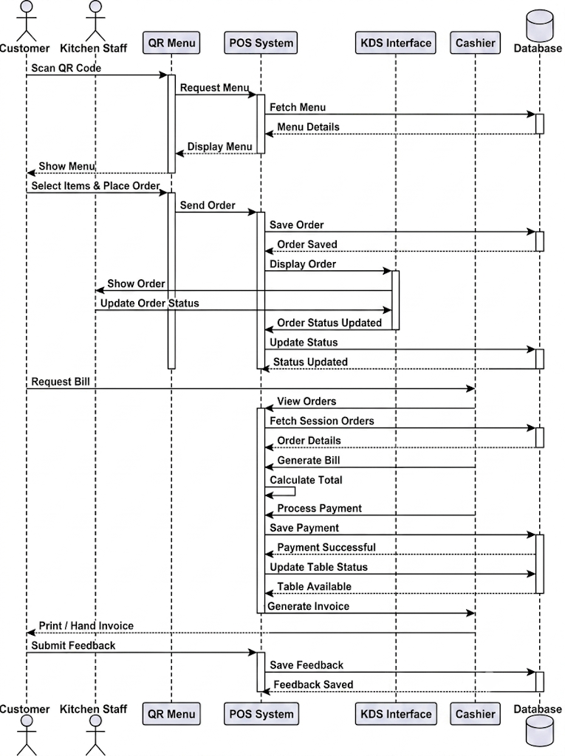
    Sequence diagram
Menu Fetch: Customer QR scan loads the live menu from the database.
Order Sync: Orders save to the database and instantly push to the KDS.
Status Updates: Kitchen updates KDS; changes sync back to the database.
Checkout: Cashier fetches orders, processes payment, and table status resets.
Feedback: Post-payment customer reviews are saved

Slide 15
Table Designs

Slide 16
Roles
Purpose: To define the access levels and specific user roles within the system (e.g., Admin, Cashier, Kitchen).
Field Name | Type | Constraints | Description
id | Integer | PK | Unique role ID
name | String | Unique | Admin/Cashier/Kitchen
createdAt | DateTime |  | Created time

Slide 17
Users
Field Name | Type | Constraints | Description
id | Integer | PK | User ID
fullName | String |  | Employee name
username | String | Unique | Login username
email | String | Unique | Email
password | String |  | Hashed password
roleId | Integer | FK | Role
isActive | Boolean |  | Status
createdAt | DateTime
updatedAt | DateTime
Purpose: To store employee details, secure login credentials, and assign roles for system access.

Slide 18
Categories
Purpose: To organize menu items into distinct groups for easier navigation.
Field Name | Type | Constraints | Description
id | Integer | PK | Category ID
name | String | Unique | Category
description | String |  | Description
createdAt | DateTime

Slide 19
MenuItems
Field Name | Type | Constraints | Description
id | Integer | PK | Menu ID
categoryId | Integer | FK | Category
name | String |  | Item
description | String |  | Dish description
price | Decimal |  | Cost of the item
imageUrl | String |  | Link to the image
isAvailable | Boolean |  | Availability status
createdAt | DateTime
updatedAt | DateTime
Purpose: To store details of individual food items, including pricing and availability.

Slide 20
Inventory
Field Name | Type | Constraints | Description
id | Integer | PK | Inventory record ID
menuItemId | Integer | FK | Linked menu item
dailyLimit | Integer |  | Daily quantity
remainingQty | Integer |  | Remaining quantity
updatedAt | DateTime |  | Last stock update
Purpose: To store details of individual food items, including pricing and availability.

Slide 21
RESTAURANT
TABLES
Field Name | Type | Constraints | Description
id | Integer | PK | Unique table ID
tableNumber | Integer | Unique | Physical table number
capacity | Integer |  | Total seats
status | Enum |  | Availability state
qrCode | String |  | Scannable link
createdAt | DateTime
Purpose: To maintain physical table layouts and QR codes.

Slide 22
DINING
SESSIONS
Field Name | Type | Constraints | Description
id | Integer | PK | Session ID
tableId | Integer | FK | Assigned table
sessionCode | String | Unique | Unique access code
startTime | DateTime |  | Seating time
endTime | DateTime |  | Completion time
status | Enum |  | Session progress
totalAmount | Decimal |  | Final bill value
Purpose: To securely manage customer dining instances and link orders.

Slide 23
ORDERS
Field Name | Type | Constraints | Description
id | Integer | PK | Main order ID
diningSessionId | Integer | FK | Linked session
orderNumber | String | Unique | Ticket number
status | Enum |  | Preparation state
orderedAt | DateTime |  | Submission time
notes | String |  | Special requests
Purpose: To log overall KOTs submitted during an active session.

Slide 24
ORDER
ITEMS
Field Name | Type | Constraints | Description
id | Integer | PK | Row entry ID
orderId | Integer | FK | Linked main order
menuItemId | Integer | FK | Ordered dish
quantity | Integer |  | Number of portions
price | Decimal |  | Unit cost
subtotal | Decimal |  | Total for item
Purpose: To record exact quantities and prices of individual items within an order.

Slide 25
PAYMENTS
Field Name | Type | Constraints | Description
id | Integer | PK | Payment ID
diningSessionId | Integer | FK, Unique | Billed session
amount | Decimal |  | Money paid
paymentMethod | Enum |  | Cash or UPI
paymentStatus | Enum |  | Success/Fail state
paidAt | DateTime |  | Transaction time
Purpose: To store financial transaction records and statuses

Slide 26
Form Design

Slide 27
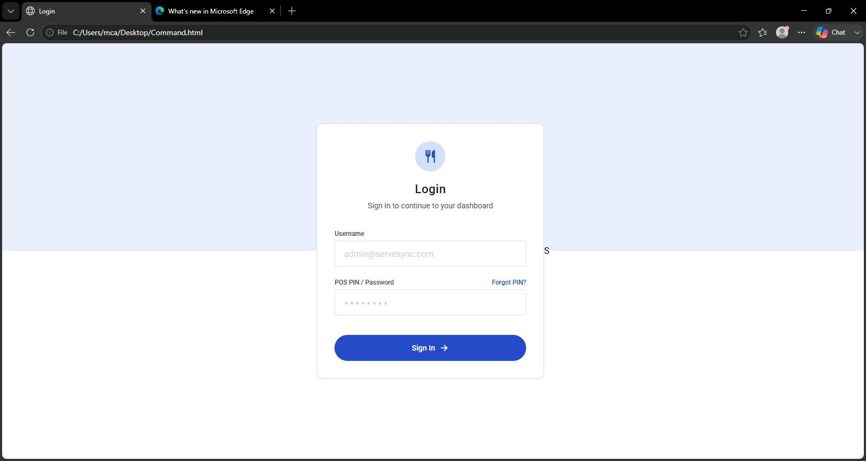

Slide 28
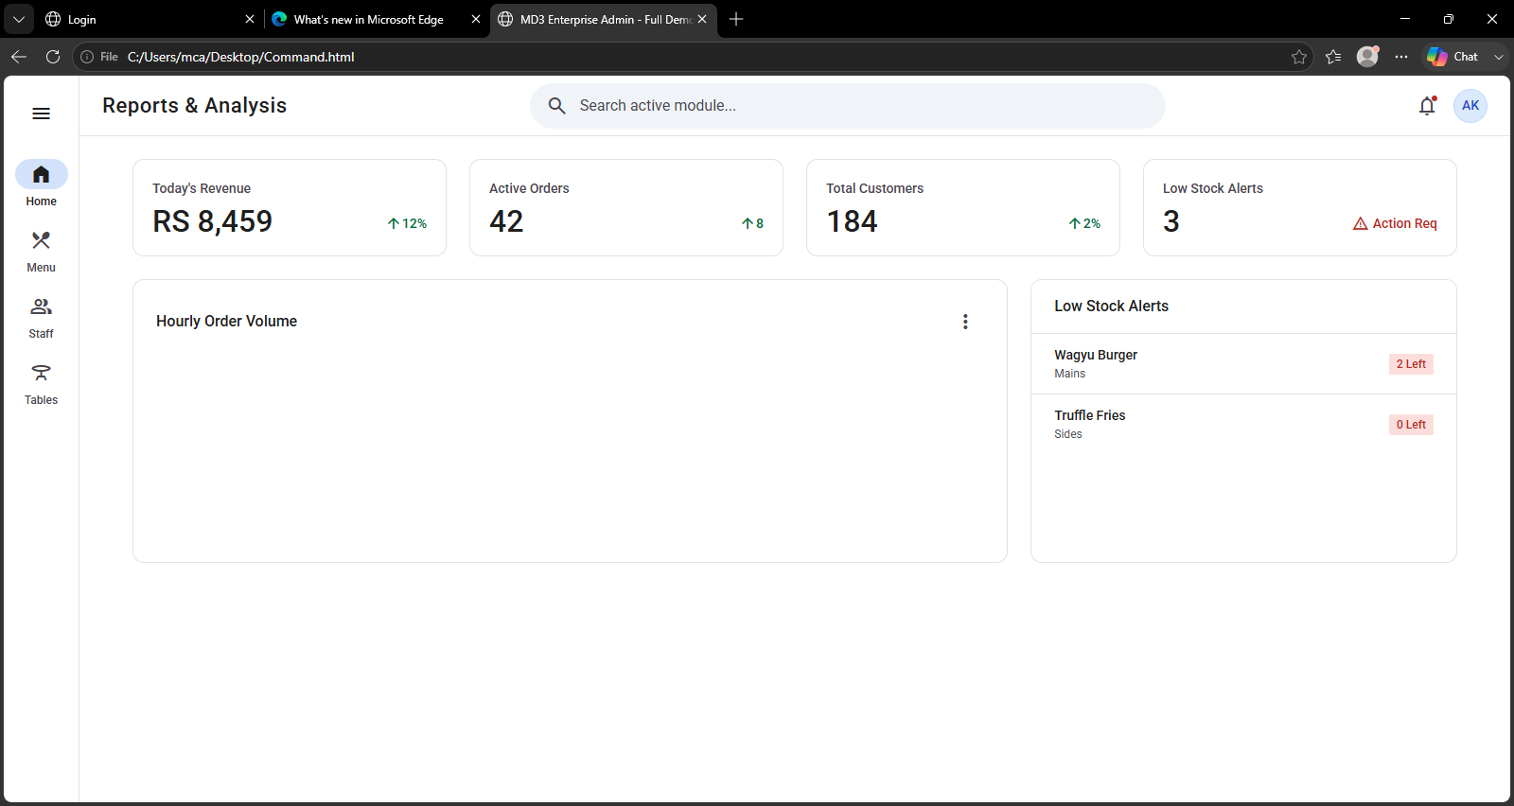

Slide 29
Thank you

